Slide 1

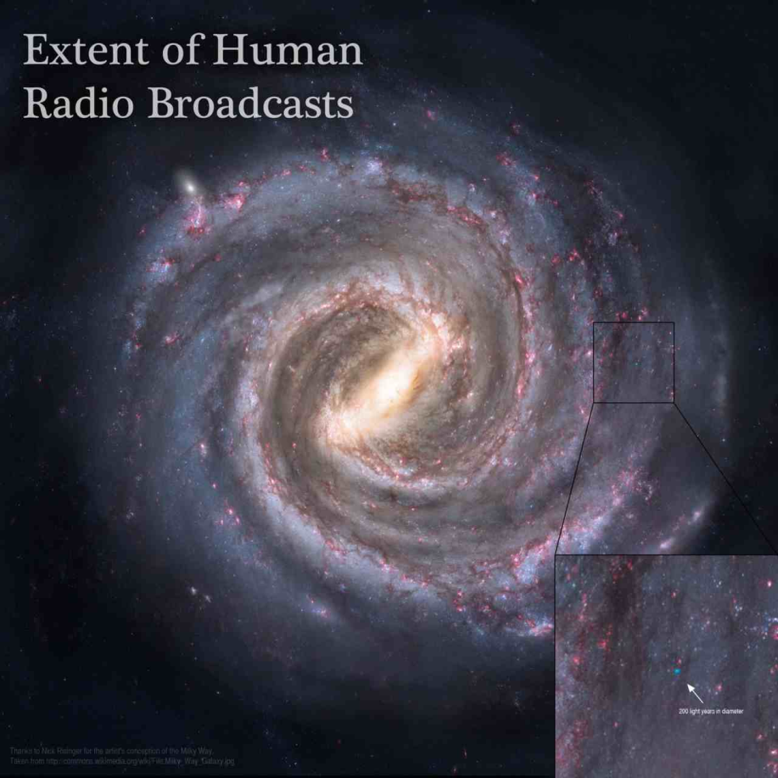
Where are they?
English language of physics, technics and Informatics:
„Fermi paradox”

Slide 2
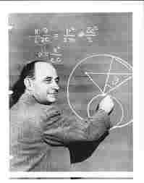
1.1 Basis of the paradox
The formulation of the paradox
The apparent size and age of the universe suggest that many technologically advanced extraterrestrial civilizations ought to exist.
However, this hypothesis seems inconsistent with the lack of observational evidence to support it.
That raises a question:
Where are they?

Slide 3
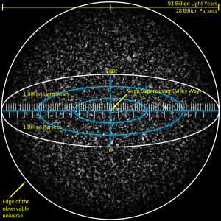
1.2 Basis of the paradox
The argument by scale
The first aspect of the paradox, "the argument by scale", is a function of the raw numbers involved: there are an estimated 200–400 billion (2–4 ×10^11) stars in the Milky Way and 70 sextillion (7×10^22) in the visible universe. Even if intelligent life occurs on only a minuscule percentage of planets around these stars, there might still be a great number of civilizations extant in the Milky Way galaxy alone. This argument also assumes the mediocrity principle, which states that Earth is not special, but merely a typical planet, subject to the same laws, effects, and likely outcomes as any other world.

Slide 4
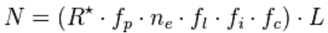
1.3 Basis of the paradox
Drake equation
where:
N = the number of civilizations in our galaxy with which communication might be possible (i.e. which are on our current past light cone);
R* = the average number of star formation per year in our galaxy
fp = the fraction of those stars that have planets
ne = the average number of planets that can potentially support life per star that has planets
fl = the fraction of planets that could support life that actually develop life at some point
fi = the fraction of planets with life that actually go on to develop intelligent life (civilizations)
fc = the fraction of civilizations that develop a technology that releases detectable signs of their existence into space
L = the length of time for which such civilizations release detectable signals into space

Slide 5
1.4 Basis of the paradox
Exploration
The Fermi paradox can be asked in two ways. The first is, "Why are no aliens or their artifacts physically here?" If interstellar travel is possible, even the "slow" kind nearly within the reach of Earth technology, then it would only take from 5 million to 50 million years to colonize the galaxy. This is a relatively small amount of time on a geological scale, let alone a cosmological one. Since there are many stars older than the Sun, or since intelligent life might have evolved earlier elsewhere, the question then becomes why the galaxy has not been colonized already. Even if colonization is impractical or undesirable to all alien civilizations, large-scale exploration of the galaxy is still possible; the means of exploration and theoretical probes involved are discussed extensively below. However, no signs of either colonization or exploration have been generally acknowledged.

Slide 6
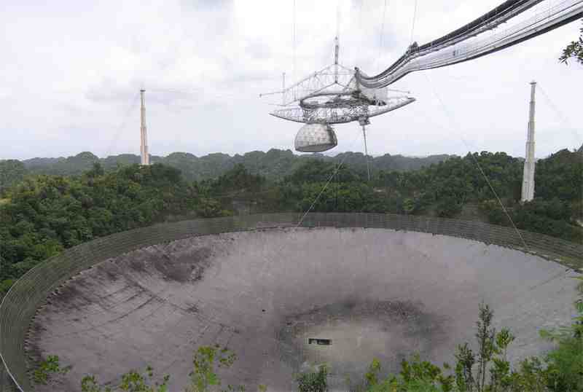
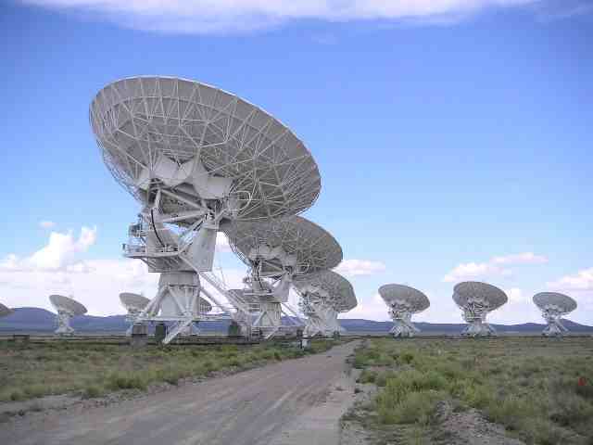
2.1 Empirical resolut. attempts
Radio emissions (1)
Radio technology and the ability to construct a radio telescope are presumed to be a natural advance for technological species, theoretically creating effects that might be detected over interstellar distances. Sensitive observers of the Solar System, for example, would note unusually intense radio waves for a G2 star due to Earth's television and telecommunication broadcasts. In the absence of an apparent natural cause, alien observers might infer the existence of a terrestrial civilization. It should be noted however that even much more sensitive radio telescopes than those currently available on Earth would not be able to detect non-directional radio signals even at a fraction of a light year, so it is questionable whether any such signals could be detected by an extraterrestrial civilization.

Slide 7
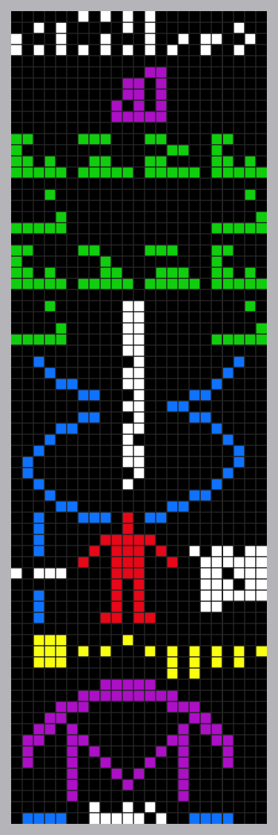
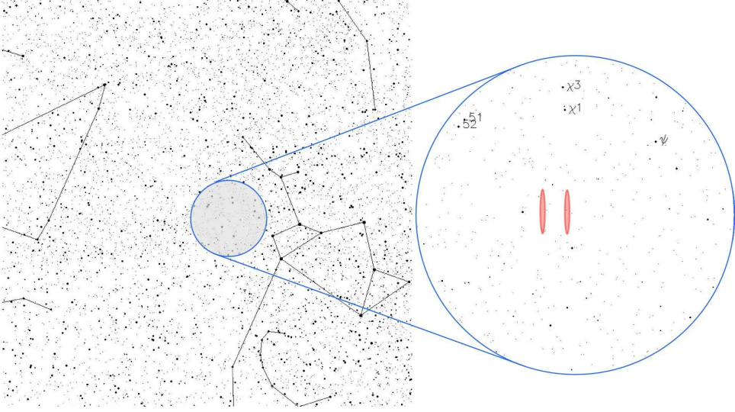
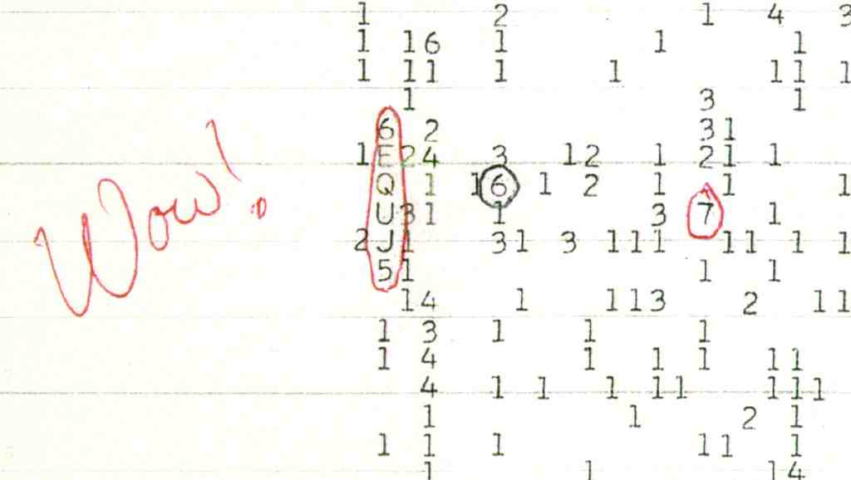
2.2 Empirical resolut. attempts
Radio emissions (2)
Several decades of SETI analysis have not revealed any main sequence stars with unusually bright or meaningfully repetitive radio emissions, although there have been several candidate signals. On August 15, 1977 the "Wow! signal" was picked up by The Big Ear radio telescope. However, the Big Ear only looked at each point on the sky for 72 seconds, and re-examinations of the same spot have found nothing. In 2003, Radio source SHGb02+14a was isolated by SETI@home analysis, although it has largely been discounted by further study. There are numerous technical assumptions underlying SETI that may cause human beings to miss radio emissions with present search techniques; these are discussed below.

Slide 8

2.3 Empirical resolut. attempts
Direct planetary observation (1)
Detection and classification of exoplanets has come out of recent refinements in mainstream astronomical instruments and analysis. While this is a new field in astronomy—the first published paper claiming to have discovered an exoplanet was released in 1989—it is possible that planets which are likely able to support life will be found in the near future.
Direct evidence for the existence of life may eventually be observable, such as the detection of biotic signature gases (such as methane and oxygen)—or even the industrial air pollution of a technologically advanced civilization—in an exoplanet's atmosphere by means of spectrographic analysis. With improvements in our observational capabilities, it may eventually even be possible to detect direct evidence such as that which humanity produces.
However, exoplanets are rarely directly observed (the first claim to have done so was made in 2004); rather, their existence is usually inferred from the effects they have on the star(s) they orbit. This means that usually only the mass and orbit of an exoplanet can be deduced. This information, along with the stellar classification of its sun, and educated guesses as to its composition (usually based on the mass of the planet, and its distance from its sun), allows only for rough approximations of the planetary environment.

Slide 9
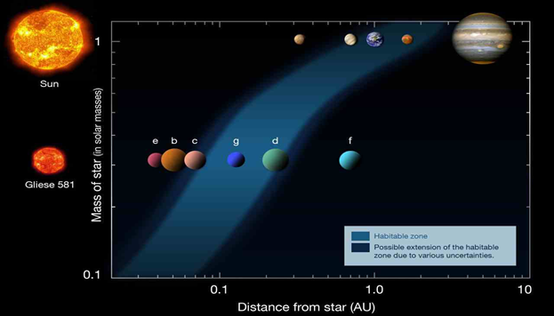
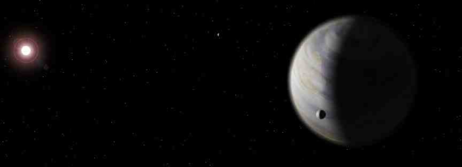
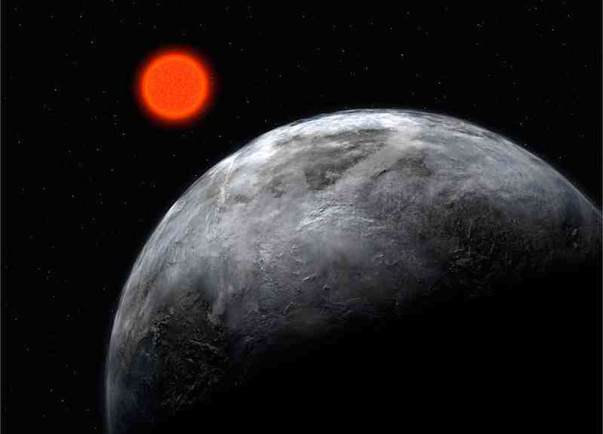
2.4 Empirical resolut. attempts
Direct planetary observation (2)
Prior to 2009, methods for exoplanet detection were not likely to detect life-bearing Earth-like worlds. Methods such as gravitational microlensing can detect the presence of "small" worlds, potentially even smaller than the Earth, but can only detect such worlds for very brief moments of time, and no follow-up is possible. Other methods such as radial velocity, astrometry, and the transit method allow prolonged observations of exoplanet effects, but only work with worlds that are many times the mass of Earth, at least when performed while looking through the atmosphere. These seem unlikely candidates to harbor Earth-like life. However, exoplanet detection and classification is a very active sub-discipline in astronomy, with 424 such planets being detected between 1988 and 2010, and the first possibly terrestrial planet discovered within a star's habitable zone being found in 2007. New refinements in exoplanet detection methods, and use of existing methods from space, (such as the Kepler Mission, launched in 2009) are expected to detect and characterize terrestrial-size planets, and determine if they are within the habitable zones of their stars. Such observational refinements may allow us to better gauge how common potentially habitable worlds are. Using methods like the Drake equation with this data would therefore allow a much better idea of how common life in the universe might be; this would have a profound influence over the expectations behind the Fermi paradox itself.

Slide 10
2.5 Empirical resolut. attempts
Alien constructs (1) - Probes, colonies, and other artifacts
As noted, given the size and age of the universe, and the relative rapidity at which dispersion of intelligent life can in principle occur, evidence of alien colonization attempts might plausibly be discovered. Evidence of exploration not containing extraterrestrial life, such as probes and information gathering devices, may also await discovery.
Von Neumann probe
Some theoretical exploration techniques such as the Von Neumann probe (a self-replicating device) could exhaustively explore a galaxy the size of the Milky Way in as little as half a million years, with comparatively little investment in materials and energy relative to the results. If even a single civilization in the Milky Way attempted this, such probes could spread throughout the entire galaxy. Evidence of such probes might be found in the Solar System—perhaps in the asteroid belt where raw materials would be plentiful and easily accessed
Bracewell probe
Another possibility for contact with an alien probe—one that would be trying to find human beings—is an alien Bracewell probe. Such a device would be an autonomous space probe whose purpose is to seek out and communicate with alien civilizations (as opposed to Von Neumann probes, which are usually described as purely exploratory). These were proposed as an alternative to carrying a slow speed-of-light dialogue between vastly distant neighbours. Rather than contending with the long delays a radio dialogue would suffer, a probe housing an artificial intelligence would seek out an alien civilization to carry on a close range communication with the discovered civilization. The findings of such a probe would still have to be transmitted to the home civilization at light speed, but an information-gathering dialogue could be conducted in real time.
Since the 1950s, direct exploration has been carried out on a small fraction of the Solar System and no evidence that it has ever been visited by alien colonists, or probes, has been uncovered. Detailed exploration of areas of the Solar System where resources would be plentiful—such as the asteroids, the Kuiper belt, the Oort cloud and the planetary ring systems—may yet produce evidence of alien exploration, though these regions are vast and difficult to investigate. There have been preliminary efforts in this direction in the form of the SETA and SETV projects to search for extraterrestrial artifacts or other evidence of extraterrestrial visitation within the Solar System.[38] There have also been attempts to signal, attract, or activate Bracewell probes in Earth's local vicinity, including by scientists Robert Freitas and Francisco Valdes.[39] Many of the projects that fall under this umbrella are considered "fringe" science by astronomers and none of the projects has located any artifacts.
Should alien artifacts be discovered, even here on Earth, they may not be recognizable as such. The products of an alien mind and an advanced alien technology might not be perceptible or recognizable as artificial constructs. Exploratory devices in the form of bio-engineered life forms created through synthetic biology would presumably disintegrate after a point, leaving no evidence; an alien information gathering system based on molecular nanotechnology could be all around us at this very moment, completely undetected. The same might be true of civilizations that actively hide their investigations from us, for possible reasons described further in this article. Also, Clarke's third law suggests that an alien civilization well in advance of humanity's might have means of investigation that are not yet conceivable to human beings.

Slide 11
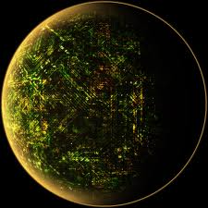
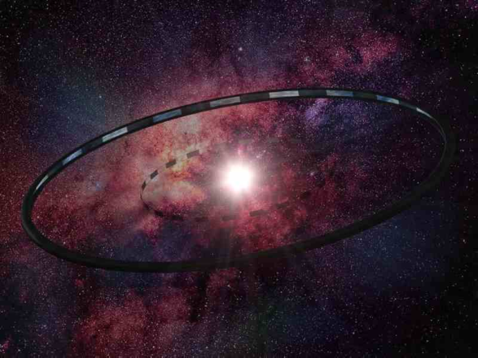
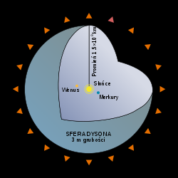
2.6 Empirical resolut. attempts
Alien constructs (2) - Advanced stellar-scale artifacts
Dyson sphere
In 1959, Freeman Dyson observed that every developing human civilization constantly increases its energy consumption, and theoretically, a civilization of sufficient age would require all the energy produced by its star. The Dyson Sphere was the thought experiment that he derived as a solution: a shell or cloud of objects enclosing a star to harness as much radiant energy as possible. Such a feat of astroengineering would drastically alter the observed spectrum of the star involved, changing it at least partly from the normal emission lines of a natural stellar atmosphere, to that of a black body radiation, probably with a peak in the infrared. Dyson himself speculated that advanced alien civilizations might be detected by examining the spectra of stars, searching for such an altered spectrum.
Matrioshka brain
Since then, several other theoretical stellar-scale megastructures have been proposed, but the central idea remains that a highly advanced civilization—Type II or greater on the Kardashev scale—could alter its environment enough as to be detectable from interstellar distances.
However, such constructs may be more difficult to detect than originally thought. Dyson spheres might have different emission spectra depending on the desired internal environment; life based on high-temperature reactions may require a high temperature environment, with resulting "waste radiation" in the visible spectrum, not the infrared.[41] Additionally, a variant of the Dyson sphere has been proposed which would be difficult to observe from any great distance; a Matrioshka brain is a series of concentric spheres, each radiating less energy per area than its inner neighbour. The outermost sphere of such a structure could be close to the temperature of the interstellar background radiation, and thus be all but invisible.

Slide 12
3.1.1 Theoretical solutions
They do NOT exist…
The simplest solution to the paradox is that Earth is the only living place in the whole galaxy and maybe in the whole universe.
…and never existed
Those who believe that extraterrestrial intelligent life does not exist argue that the conditions needed for life—or at least complex life—to evolve are rare or even unique to Earth. This is known as the Rare Earth hypothesis, which attempts to resolve the Fermi paradox by rejecting the mediocrity principle, and asserting that Earth is not typical, but unusual or even unique. While a unique Earth has historically been assumed on philosophical or religious grounds, the Rare Earth Hypothesis uses quantifiable and statistical arguments to argue that multicellular life is exceedingly rare in the universe because Earth-like planets are themselves exceedingly rare and/or many improbable coincidences have converged to make complex life on Earth possible. It is possible that complex life may evolve through other mechanisms than those found specifically here on Earth, but the fact that in the history of life on the Earth only one species has developed a civilization to the point of being capable of space flight and radio technology lends more credence to the idea of technologically advanced civilizations being rare in the universe.
„Happy” developed Earth’s parameters:
Galactic sphere of life
Star of special type
Planetary system
Size of the planet
Big moon
Magnetic field
Tectonics
atmosphere
Evolutionary „kicks”

Slide 13
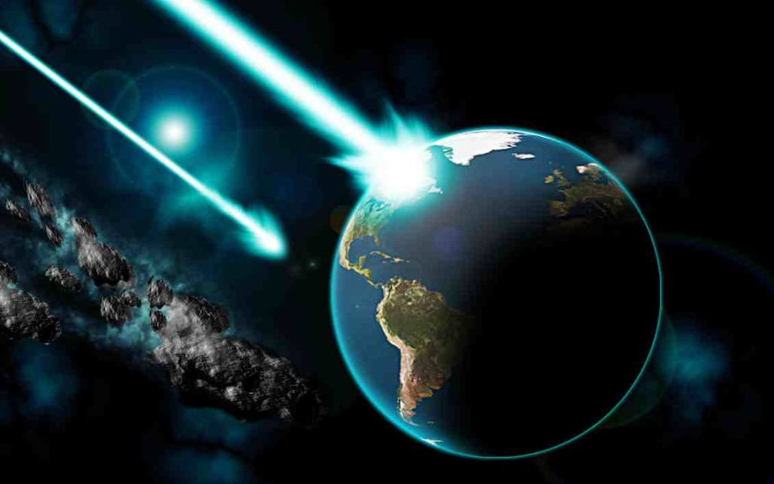
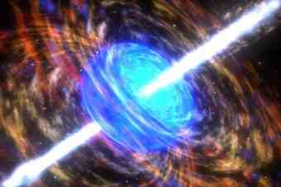
3.1.2 Theoretical solutions
They do NOT exist…
…because life is periodically destroyed by naturally occurring events
On Earth, there have been numerous major extinction events that destroyed the majority of complex species alive at the time. The extinction of the dinosaurs is the best known example. These are believed to be caused by events such as impact from a large meteorite, massive volcanic eruptions, or astronomical events such as gamma ray bursts. It may be the case that such extinction events are common throughout the universe and periodically destroy intelligent life (or at least destroy their civilizations) before the species is able to develop the technology to communicate with other species.

Slide 14

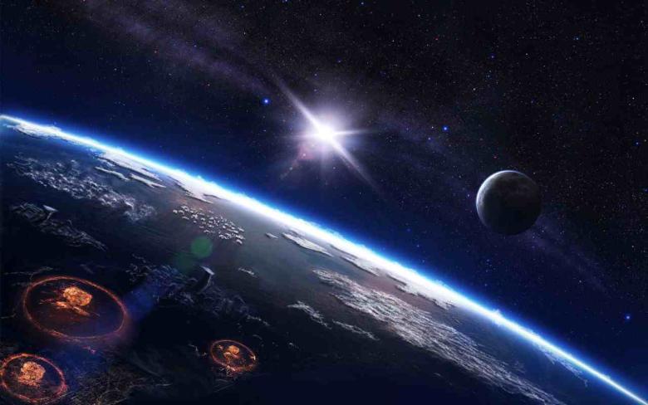

3.1.2 Theoretical solutions
They do NOT exist…
…because it is the nature of intelligent life to destroy itself
This is the argument that technological civilizations may usually or invariably destroy themselves before or shortly after developing radio or space flight technology. Possible means of annihilation include nuclear war, biological warfare or accidental contamination, climate change, nanotechnological catastrophe, ill-advised physics experiments, a badly programmed super-intelligence, or a Malthusian catastrophe after the deterioration of a planet's ecosphere.
From a Darwinian perspective, self-destruction would be an ironic outcome of evolutionary success. The evolutionary psychology that developed during the competition for scarce resources over the course of human evolution has left the species subject to aggressive, instinctual drives. These compel humanity to consume resources, extend longevity, and to reproduce—in part, the very motives that led to the development of technological society. It seems likely that intelligent extraterrestrial life would evolve in a similar fashion and thus face the same possibility of self-destruction. And yet, to provide a good answer to Fermi's Question, self-destruction by technological species (or any sociological explanation) would have to be a near universal occurrence. Otherwise, the few civilizations to which it does not apply would colonize the galaxy.

Slide 15


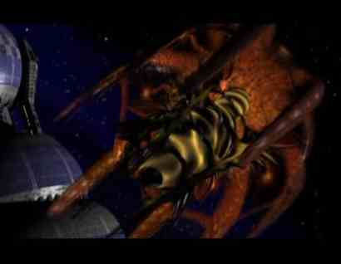

3.1.3 Theoretical solutions
They do NOT exist…
…because it is the nature of intelligent life to destroy others
Another possibility is that an intelligent species beyond a certain point of technological capability will destroy other intelligence as it appears, as is exemplified by the theorized extermination of Neanderthals by early humans. The idea that something, or someone, is destroying intelligent life in the universe has been well explored in science fiction and scientific literature.
This hypothesis requires at least one civilization to have arisen in the past, and the first civilization would not have faced this problem. However, it could still be that Earth is alone now. Like exploration, the extermination of other civilizations might be carried out with self-replicating spacecraft. Under such a scenario, even if a civilization that created such machines were to disappear, the probes could outlive their creators, destroying civilizations far into the future.
If true, this argument reduces the number of visible civilizations in two ways—by destroying some civilizations, and forcing others to remain quiet, under fear of discovery (They choose not to interact with us) so we would see no signs of them. This may also make it impossible for life to evolve in regions of the universe close to a developed civilization, assuring that any new civilizations will start off far away from preexisting ones.

Slide 16

3.1.4 Theoretical solutions
They do NOT exist…
…because god (or gods) created only Human beings
Philosophers such as Aristotle and religious thinkers such as Thomas Aquinas claim that human beings are unique in the divine plan and counsel against belief in intelligent life on other worlds. Aristotle believed the element of the heavens was Fire, as opposed to Earth, and so the heavens could not support life. Thomas Aquinas additionally believed the uniqueness of God implied the uniqueness of Earth, and also notes the Bible refers to the world in the singular.
Religious reasons for doubting the existence of extraterrestrial intelligent life resemble some forms of the Rare Earth Hypothesis. The argument here would be a teleological form of the strong anthropic principle: the universe was designed for the express purpose of creating human (and only human) intelligence. This argument presupposes that a prior advanced intelligence existed in order to create human life, which might pose the question whether that intelligence was the only one to exist before it created us, but the perspective is a philosophical and abstract one.

Slide 17
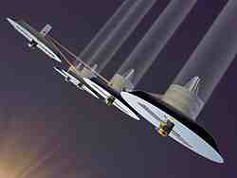
3.2.1.1 Theoretical solutions
They do exist…
It may be that technological extraterrestrial civilizations exist, but that human beings cannot communicate with them because of constraints: problems of scale or of technology; because they do not wish to communicate or their nature is simply too alien for meaningful communication, or perhaps even be recognized as technology.
…but communication is impossible…
...because intelligent civilizations are too far apart in space
It may be that non-colonizing technologically capable alien civilizations exist, but that they are simply too far apart for meaningful two-way communication. If two civilizations are separated by several thousand light years, it is very possible that one or both cultures may become extinct before meaningful dialogue can be established. Human searches may be able to detect their existence, but communication will remain impossible because of distance. This problem might be ameliorated somewhat if contact/communication is made through a Bracewell probe. In this case at least one partner in the exchange may obtain meaningful information. Alternatively, a civilization may simply broadcast its knowledge, and leave it to the receiver to make what they may of it. This is similar to the transmission of information from ancient civilizations to the present,[67] and humanity has undertaken similar activities like the Arecibo message, which could transfer information about Earth's intelligent species, even if it never yields a response (or does not yield a response in time for humanity to receive it). It is also possible that archaeological evidence of past civilizations may be detected through deep space observations—especially if they left behind large artifacts such as Dyson spheres.

Slide 18


3.2.1.2 Theoretical solutions
They do exist…
…but communication is impossible…
...because civilizations exist for too short time
The problem of distance is compounded by the fact that timescales affording a "window of opportunity" for detection or contact might be quite small. Advanced civilizations may periodically arise and fall throughout our galaxy, but this may be such a rare event, relatively speaking, that the odds of two or more such civilizations existing at the same time are low. There may have been intelligent civilizations in the galaxy before the emergence of intelligence on Earth, and there may be intelligent civilizations after its extinction, but it is possible that human beings are the only intelligent civilization in existence now. The term "now" is somewhat complicated by the finite speed of light and the nature of spacetime under relativity. Assuming that an extraterrestrial intelligence is not able to travel to our vicinity at faster-than-light speeds, in order to detect an intelligence 1,000 light-years distant, that intelligence will need to have been active 1,000 years ago. Strictly speaking, only the portions of the universe lying within the past light cone of Earth need be considered, since any civilizations outside it could not be detected. Another issue is the possibly very small length of time (even in historical timescales) that a civilization might be 'loudly' broadcasting material that could be reasonably detected.

Slide 19


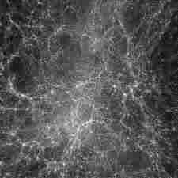
3.2.1.3 Theoretical solutions
They do exist…
…but communication is impossible…
...because no other civilization has arisen yet
Another possibility is that Earth is the first planet in the Milky Way on which industrial civilization has arisen. However, critics note that according to current understanding, many Earth-like planets were created many billions of years prior to Earth, so this explanation requires repudiation of the mediocrity principle…
…but someone need to be the first, so maybe we are

Slide 20

3.2.1.4 Theoretical solutions
They do exist…
…but communication is impossible…
...because it is too expensive to spread physically throughout the galaxy
Many assumptions about the ability of an alien culture to colonize other stars are based on the idea that interstellar travel is technologically feasible. While the current understanding of physics rules out the possibility of faster than light travel, it appears that there are no major theoretical barriers to the construction of "slow" interstellar ships. This idea underlies the concept of the Von Neumann probe and the Bracewell probe as evidence of extraterrestrial intelligence.
It is possible, however, that present scientific knowledge cannot properly gauge the feasibility and costs of such interstellar colonization. Theoretical barriers may not yet be understood and the cost of materials and energy for such ventures may be so high as to make it unlikely that any civilization could afford to attempt it. Even if interstellar travel and colonization are possible, they may be difficult, leading to a colonization model based on percolation theory.[70] Colonization efforts may not occur as an unstoppable rush, but rather as an uneven tendency to "percolate" outwards, within an eventual slowing and termination of the effort given the enormous costs involved and the fact that colonies will inevitably develop a culture and civilization of their own. Colonization may thus occur in "clusters," with large areas remaining uncolonized at any one time.

Slide 21
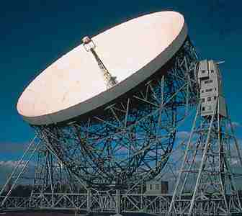

3.2.1.5 Theoretical solutions
They do exist…
…but communication is impossible…
...because human beings have not been searching long enough
Humanity's ability to detect and comprehend intelligent extraterrestrial life has existed for only a very brief period—from 1937 onwards, if the invention of the radio telescope is taken as the dividing line—and Homo sapiens is a geologically recent species. The whole period of modern human existence to date (about 200,000 years) is a very brief period on a cosmological scale, while radio transmissions have only been propagated since 1895. Thus it remains possible that human beings have neither been searching long enough to find other intelligences, nor been in existence long enough to be found.
One million years ago there would have been no humans for any extraterrestrial emissaries to meet. For each further step back in time, there would have been increasingly fewer indications to such emissaries that intelligent life would develop on Earth. In a large and already ancient universe, a space-faring alien species may well have had many other more promising worlds to visit and revisit. Even if alien emissaries visited in more recent times, they may have been interpreted by early human cultures as supernatural entities.

Slide 22
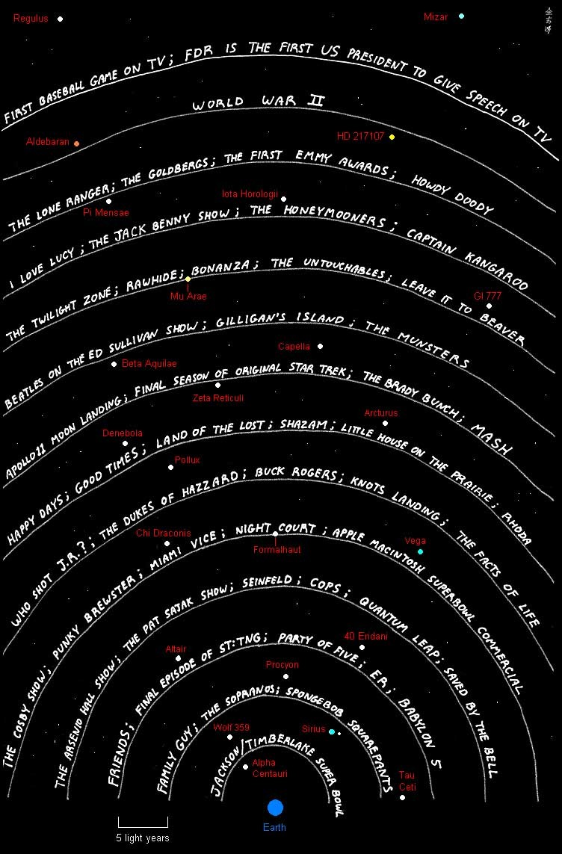
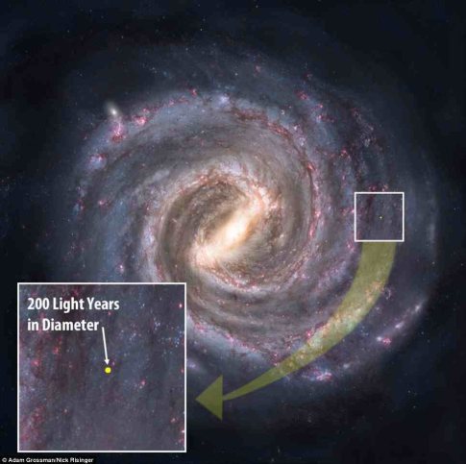

3.2.1.6 Theoretical solutions
They do exist…
…but communication is impossible…
... because aliens have not yet had time to respond
A related argument holds that other civilizations exist, and are transmitting and exploring, but their signals and probes simply have not arrived yet. However, critics have noted that this is unlikely, since it requires that humanity's advancement has occurred at a very special point in time, while the Milky Way is in transition from empty to full. This is a tiny fraction of the life of a galaxy under ordinary assumptions and calculations resulting from them, so the likelihood that we're in the midst of this transition is considered low in the paradox.

Slide 23
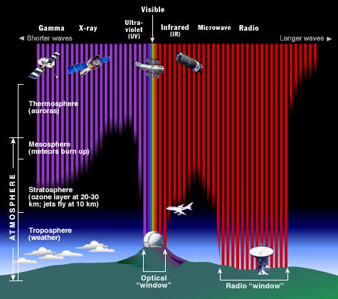
3.2.1.7 Theoretical solutions
They do exist…
…but communication is impossible…
...humans are not listening properly
There are some assumptions that underlie the SETI search programs that may cause searchers to miss signals that are present. For example, the radio searches to date would completely miss highly compressed data streams (which would be almost indistinguishable from "white noise" to anyone who did not understand the compression algorithm). Extraterrestrials might also use frequencies that scientists have decided are unlikely to carry signals, or do not penetrate our atmosphere (e.g., gamma rays), or use modulation strategies that are not being looked for. The signals might be at a data rate that is too fast for our electronics to handle, or too slow to be recognised as attempts at communication. "Simple" broadcast techniques might be employed, but sent from non-main sequence stars which are searched with lower priority; current programs assume that most alien life will be orbiting Sun-like stars.
The greatest problem is the sheer size of the radio search needed to look for signals (effectively spanning the entire visible universe), the limited amount of resources committed to SETI, and the sensitivity of modern instruments. SETI estimates, for instance, that with a radio telescope as sensitive as the Arecibo Observatory, Earth's television and radio broadcasts would only be detectable at distances up to 0.3 light years.[75] Clearly detecting an Earth type civilization at great distances is difficult. A signal is much easier to detect if the signal energy is limited to either a narrow range of frequencies (narrowband transmissions), and/or directed at a specific part of the sky.

Slide 24
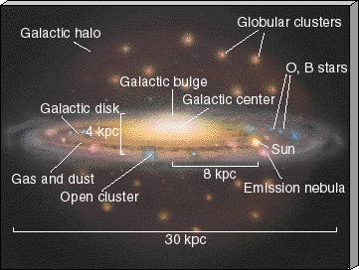
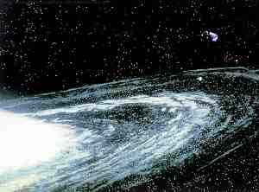
3.2.1.8 Theoretical solutions
They do exist…
…but communication is impossible…
...because they’re all hanging out at the edge of the galaxy
This interesting solution to the Fermi Paradox was posited by Milan M. Ćirković and Robert Bradbury.
“We suggest that the outer regions of the Galactic disk are the most likely locations for advanced SETI targets,” they wrote. The reason for this is that sophisticated intelligent communities will tend to migrate outward through the Galaxy as their capacities of information-processing increase. Why? Because machine-based civilizations, with their massive supercomputers, will have huge problems managing their heat waste. They'll have to set up camp where it’s super cool. And the outer rim of the Galaxy is exactly that.
Subsequently, there may be a different galactic habitable zone for post-Singularity ETIs than for meat-based life. By consequence, advanced ETIs have no interest in exploring the bio-friendly habitable zone. Which means we’re looking for ET in the wrong place. Interestingly, Stephen Wolfram once told me that heat-free computing will someday be possible, so he doesn’t think this is a plausible solution to the Fermi Paradox.

Slide 25

3.2.1.9 Theoretical solutions
They do exist…
…but communication is impossible…
...because civilizations broadcast detectable radio signals only for a brief period of time
It may be that alien civilizations are detectable through their radio emissions for only a short time, reducing the likelihood of spotting them. There are two possibilities in this regard: civilizations outgrow radio through technological advance or, conversely, resource depletion cuts short the time in which a species broadcasts.
The first idea, that civilizations advance beyond radio, is based in part on the "fiber optic objection": the use of high power radio with low-to-medium gain (i.e., non-directional) antennas for long-distance transmission is wasteful of spectrum, yet this "waste" is precisely what makes these systems conspicuous at interstellar distances. Humans are moving to directional or guided transmission channels such as electrical cables, optical fibers, narrow-beam microwave and lasers, and conventional radio with non-directional antennas is increasingly reserved for low-power, short-range applications such as cell phones and Wi-Fi networks. These signals are far less detectable from space. Analog television, developed in the mid-20th century, contains strong carriers to aid reception and demodulation. Carriers are spectral lines that are very easily detected yet do not convey any information beyond their highly artificial nature. Nearly every SETI project is looking for carriers for just this reason, and UHF TV carriers are the most conspicuous and artificial signals from Earth that could be detected at interstellar distances. But advances in technology are replacing analog TV with digital television which uses spectrum more efficiently by eliminating or reducing components such as carriers that make them so conspicuous. Using our own experience as an example, we could set the date of radio-visibility for Earth as December 12, 1901, when Guglielmo Marconi sent radio signals from Cornwall, England, to Newfoundland, Canada. Visibility is now ending, or at least becoming orders of magnitude more difficult, as analog TV is being phased out. And so, if our experience is typical, a civilization remains radio-visible for approximately a hundred years. So a civilization may have been very visible from 1325 to 1483, but we were just not listening at that time. This is essentially the solution, "Everyone is listening, no one is sending."

Slide 26
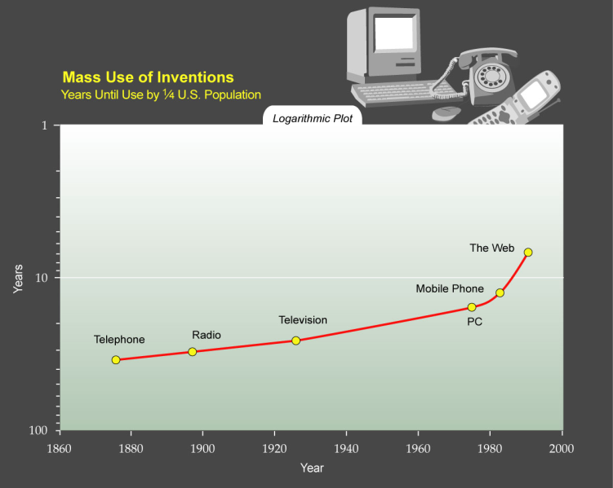
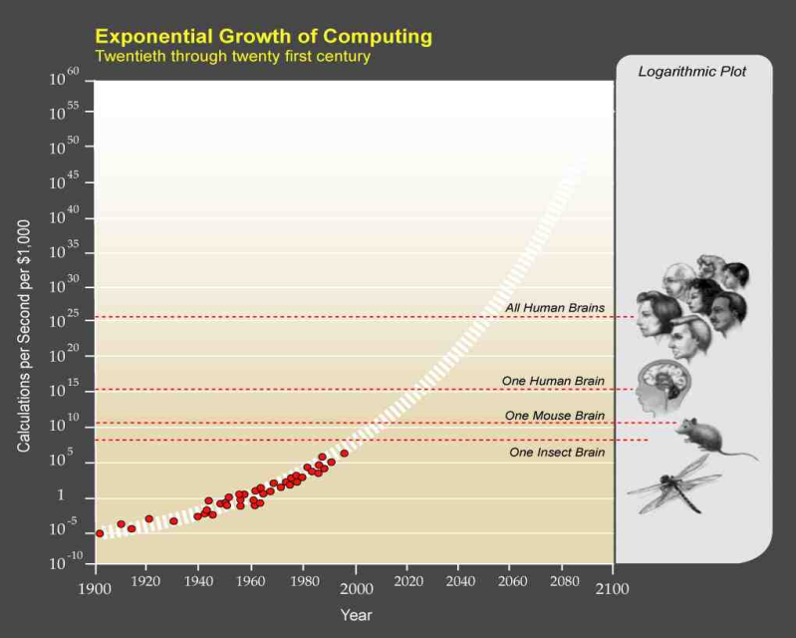
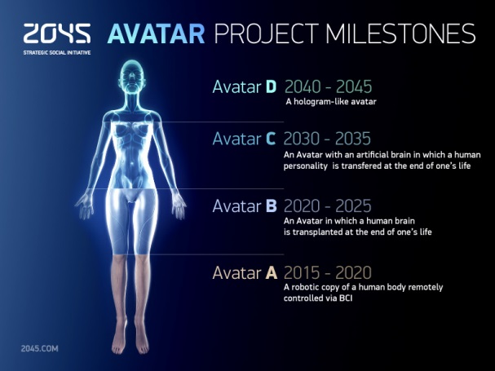
3.2.1.10 Theoretical solutions
They do exist…
…but communication is impossible…
...because they tend to experience a technological singularity
Another possibility is that technological civilizations invariably experience a technological singularity and attain a posthuman (or more properly, post-biological) character. Hypothetical civilizations of this sort may have advanced drastically enough to render communication impossible. The intelligences of a post-singularity civilization might require more information exchange than is possible through interstellar communication, for example. Or perhaps any information humanity might provide would appear elementary, and thus they do not try to communicate, any more than human beings attempt to talk to ants—even though we do ascribe a form of intelligence to them. For example, a superintelligent civilization might consist of an advanced megastructure such as a Matrioshka brain or a black hole and communicate using neutrinos or by gamma-ray bursts at bandwidths that exceed our receiving capabilities.
Even more extreme forms of post-singularity have been suggested, particularly in fiction: beings that divest themselves of physical form, create massive artificial virtual environments, transfer themselves into these environments through mind uploading, and exist totally within virtual worlds, ignoring the external physical universe. Surprisingly early treatments, such as Lewis Padgett's short story Mimsy were the Borogoves (1943), suggest a migration of advanced beings out of the presently known physical universe into a different and presumably more agreeable alternative one.

Slide 27
3.2.1.11 Theoretical solutions
They do exist…
…but communication is impossible…
... because our RF technology is too primitive
More hypothetically, advanced alien civilizations evolve beyond broadcasting at all in the electromagnetic spectrum and communicate by principles of physics we don't yet understand. Some scientists have hypothesized that advanced civilizations may send neutrino signals. If such signals exist they could be detectable by neutrino detectors that are now under construction. If stable wormholes could be created and used for communications then interstellar broadcasts would become largely redundant. Thus it may be that other civilizations would only be detectable for a relatively short period of time between the discovery of radio and the switch to more efficient technologies.
One counter to this argument is that although broadcast communication may become difficult to detect, other uses for radio such as radar and power transmission cannot be replaced by low power technologies or fiber optics. These will potentially remain visible even after broadcast emission are replaced by less observable technology.
A different argument is that resource depletion will soon result in a decline in technological capability. Human civilization has been capable of interstellar radio communication for only a few decades and is already rapidly depleting fossil fuels and confronting possible problems such as peak oil. It may only be a few more decades before energy becomes too expensive, and the necessary electronics and computers too difficult to manufacture, for us to continue the search. If the same conditions regarding energy supplies hold true for other civilizations, then radio technology may be a short-lived phenomenon. Unless two civilizations happen to be near each other and develop the ability to communicate at the same time it would be virtually impossible for any one civilization to "talk" to another.
Critics of the resource depletion argument point out that alternate energy sources exist, such as solar power, which are renewable and have enormous potential relative to technical barriers. For depletion of fossil fuels to end the "technological phase" of a civilization, some form of technological regression would have to invariably occur, preventing the exploitation of renewable energy sources.

Slide 28



3.2.1.12 Theoretical solutions
They do exist…
…but communication is impossible…
...because they are non-technological
It may be that at least some civilizations of intelligent beings are not technological, perhaps because it is difficult in their environment, or because they choose not to, or for other reasons yet unknown. Such civilizations would be very hard for humans to detect.
While there are remote sensing techniques which could perhaps detect life-bearing planets without relying on the signs of technology, none of them has any ability to tell if any detected life is intelligent. Not even any theoretical methods for doing so have been proposed, short of an actual physical visit by an astronaut or probe. This is sometimes referred to as the "algae vs. alumnae" problem.

Slide 29
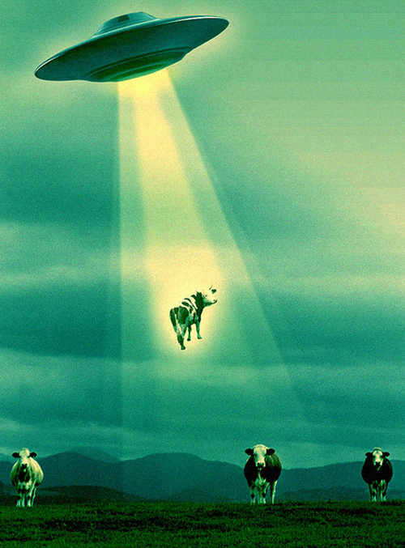

3.2.2.1 Theoretical solutions
They do exist…
...but they choose not to interact with us...
In these scenarios, alien civilizations exist that are technically capable of contacting Earth, but explicitly choose not to do so. This is the official position of the Earth today; we listen (SETI), but except for a few small efforts, do not explicitly transmit. Of course if all, or even most, civilizations act the same way, the galaxy could be full of civilizations eager for contact, but everyone is listening and no-one is transmitting. This is the so-called SETI Paradox.
...because they are not interested
The assumption that advanced civilizations tend to contacts also may be incorrect. Reasons, such as religious taboos, xenophobia or simple lack of interest, can make the aliens did not establish contact, even if they are able to it.
This explanation is associated with the famous Einstein's opinion: "The best proof of the existence of extraterrestrial intelligence is that it is not in contact with us."

Slide 30

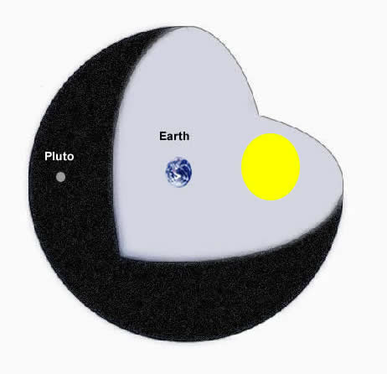
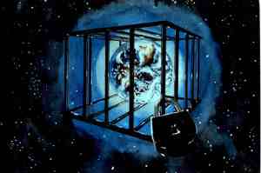
3.2.2.2 Theoretical solutions
They do exist…
...but they choose not to interact with us...
...because Earth is purposely not contacted(the zoo hypothesis)
The zoo hypothesis states that superintelligent extraterrestrial life exists and does not contact life on Earth to allow for its natural evolution and development.
These ideas are perhaps most plausible if there is a relatively universal cultural or legal policy among a plurality of extraterrestrial civilizations necessitating isolation with respect to alien life. In a Universe without a hegemonic power, random civilizations with independent principles would, in all likelihood, make contact. This makes a crowded Universe with clearly defined rules seem more plausible.
This theory may break down under the uniformity of motive flaw: all it takes is a single culture or civilization to decide to act contrary to the imperative within our range of detection for it to be abrogated, and the probability of such a violation increases with the number of civilizations. However, perhaps a sufficiently technologically and socially advanced civilization would be capable of enforcing rules.
T. W. Hair has done Monte Carlo analysis of the inter-arrival times between civilizations in the galaxy based on common astrobiological assumptions that suggest that since the initial civilization would have such a commanding lead over the later arrivals, it may have established what we call zoo hypothesis as a galactic/universal norm and the resultant "paradox" by a cultural founder effect with or without the continued activity of the founder.
Compare with the Prime Directive from Star Trek.

Slide 31




3.2.2.3 Theoretical solutions
They do exist…
...but they choose not to interact with us...
...because they are too alien
Another possibility is that human theoreticians have underestimated how much alien life might differ from that on Earth. Aliens may be psychologically unwilling to attempt to communicate with human beings. Perhaps human mathematics is parochial to Earth and not shared by other life, though others argue this can only apply to abstract math since the math associated with physics must be similar (in results, if not in methods).
Physiology might also cause a communication barrier. In Contact, Carl Sagan briefly speculated that an alien species might have a thought process orders of magnitude slower (or faster) than humans. Such a species could conceivably speak so slowly that it requires years to say even a simple phrase like "Hello". A message broadcast by that species might well seem like random background noise to humans,
and therefore go undetected.

Slide 32



3.2.2.4 Theoretical solutions
They do exist…
...but they choose not to interact with us...
...because they are too busy online
It may be that intelligent alien life forms cause their own "increasing disinterest" with the outside world.
Perhaps any sufficiently advanced society will develop highly engaging media and entertainment well before the capacity for advanced space travel, and that the rate of appeal of these social contrivances is destined, because of their inherent reduced complexity, to overtake any desire for complex, expensive endeavors such as space exploration and communication.
Once any sufficiently advanced civilization becomes able to master its environment, and most of its physical needs are met through technology, various "social and entertainment technologies", including virtual reality, are postulated to become the primary drivers and motivations of that civilization.

Slide 33


3.2.2.5 Theoretical solutions
They do exist…
...but they choose not to interact with us...
...because they don't agree among themselves
Official policy within SETI community is that "[no] response to a signal or other evidence of extraterrestrial intelligence should be sent until appropriate international consultations have taken place.".
However, given the possible impact of any reply it may be very difficult to obtain any consensus on "Who speaks for Earth?" and "What should we say?".
Other civilizations might suffer from this same lack of consensus, and therefore send no messages at all.

Slide 34
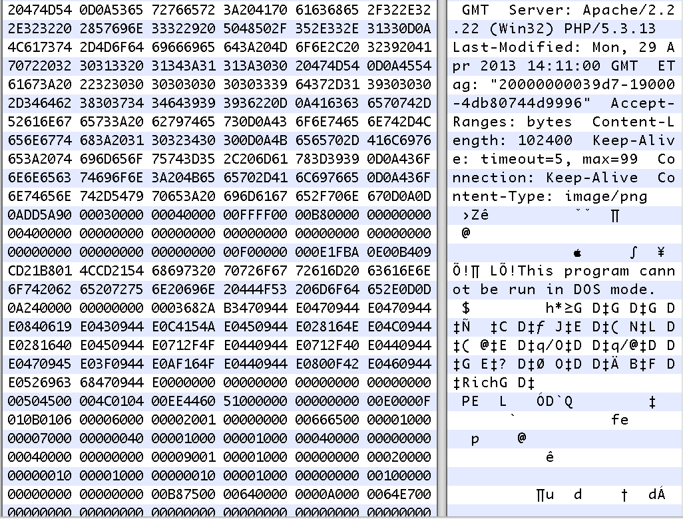

3.2.2.6 Theoretical solutions
They do exist…
...but they choose not to interact with us...
...because it is dangerous to communicate
An alien civilization might feel it is too dangerous to communicate, either for us or for them. After all, when very different civilizations have met on Earth, the results have often been disastrous for one side or the other, and the same may well apply to interstellar contact.
Even contact at a safe distance could lead to infection by computer code or even ideas themselves.
Perhaps prudent civilizations actively hide not only from us but from everyone, out of fear of other civilizations.

Slide 35

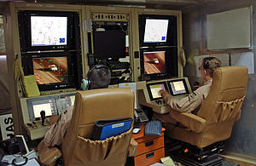
3.2.2.7 Theoretical solutions
They do exist…
...but they choose not to interact with us...
...because the Fermi paradox itself is what prevents communication
Perhaps the Fermi paradox itself—or the alien equivalent of it—is the ultimate reason for any civilization to avoid contact with other civilizations, even if no other obstacles existed.
From any one civilization's point of view, it would be unlikely for them to be the first ones to make first contact. Therefore it is likely that previous civilizations faced fatal problems with first contact.
So perhaps every civilization keeps quiet because of the possibility that there is a real reason for others to do so.

Slide 36



3.2.3.1 Theoretical solutions
They do exist…
...and they are here unobserved...
It may be that intelligent alien life forms not only exist, but are already present here on Earth. They are not detected because they do not wish it, human beings are technically unable to, or because societies refuse to admit to the evidence.
... because people do not understand or do not want to believe the evidence
UFO researchers note that the Fermi Paradox arose within the context of a wave of UFO reports, yet Fermi, Teller, York and Konopinski apparently dismissed the possibility that flying saucers might be extraterrestrial – despite contemporary US Air Force investigations that judged a small portion of UFO reports as inexplicable by contemporary technology. (Mainstream scientific publications have occasionally addressed the possibility of extraterrestrial contact,[104] but the scientific community in general has given little serious attention to claims of unidentified flying objects.) Given that UFO investigators argue compelling evidence supports the reality of UFOs as anomalies, but that extant UFO evidence does not support an extraterrestrial origin, it is suggested that closer examination of UFO data may support or falsify the Fermi paradox and/or the extraterrestrial hypothesis of UFO origins: "Any refusal of interest [by mainstream scientists] in investigating the UFO phenomenon, using an ETI [extraterrestrial intelligence] concept as one working hypothesis, should surely be astonishing.

Slide 37
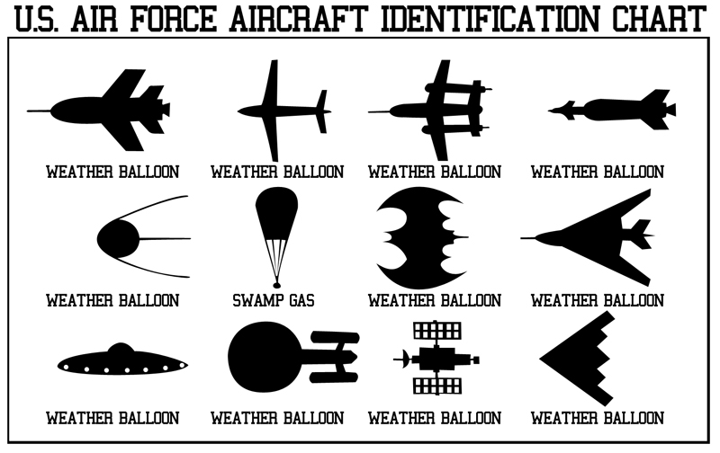
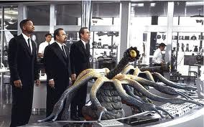
3.2.3.2 Theoretical solutions
They do exist…
...but they are invisible for us...
...because the evidence is being suppressed
It is theoretically possible that SETI groups are not reporting positive detections, or governments have been blocking extraterrestrial signals or suppressing publication of detections. This response might be attributed to National Security and Trade Interests from the potential use of advanced extraterrestrial technology or weapons. It has been suggested that the detection of an extraterrestrial radio signal or technology could well be the most highly classified military information that exists. Claims that this has already happened are common in the popular press, but the scientists involved report the opposite experience – the press becomes informed and interested in a potential detection even before a signal can be confirmed. Another issue is the diverse number of organisations and governments involved in science activities that might chance upon detections, of which SETI forms only a small part. Numerous conspiracy theories have been proposed, including the possibility of extraterrestrial life at Area 51.

Slide 38



3.2.3.3 Theoretical solutions
They do exist…
...but they are invisible for us...
... because they hide their presence
It is possible that a life form technologically advanced enough to travel to Earth might also be sufficiently advanced to exist here undetected. In this view, the aliens have arrived on Earth, or in our solar system, and are observing the planet, while concealing their presence. Observation could conceivably be conducted in a number of ways that would be very difficult to detect. For example, a complex system of microscopic monitoring devices constructed via molecular nanotechnology could be deployed on Earth and remain undetected, or sophisticated instruments could conduct passive monitoring from elsewhere while concealing themselves with stealth technologies that need not be much more advanced than current terrestrial ones.

Slide 39
3.3 Less popular theoretical solution attempts
They do NOT exist -Inflation hypothesis and the Youngness Argument
They do exist but communication is impossible because we’re the aliens (directed panspermia)
They do exist but they choose not to interact with us because we’re made out of meat
They do exist but they choose not to interact with us because of the Whack-a-Mole Hypothesis

Slide 40
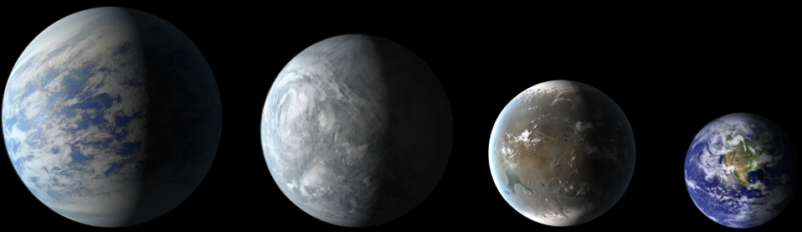
4.1 Summary
Bibliography
http://en.wikipedia.org/wiki/Fermi_paradox
http://io9.com/11-of-the-weirdest-solutions-to-the-fermi-paradox-456850746
http://www.fermisparadox.com
http://abyss.uoregon.edu/~js/cosmo/lectures/lec28.html
http://en.wikipedia.org/wiki/Project_Orion_(nuclear_propulsion)
http://en.wikipedia.org/wiki/Project_Daedalus
http://en.wikipedia.org/wiki/Project_Longshot
http://en.wikipedia.org/wiki/Self-replicating_spacecraft
http://en.wikipedia.org/wiki/Drake_equation
http://en.wikipedia.org/wiki/Rare_Earth_hypothesis
http://en.wikipedia.org/wiki/Dyson_sphere
http://en.wikipedia.org/wiki/Matrioshka_brain
http://en.wikipedia.org/wiki/Kardashev_scale
http://en.wikipedia.org/wiki/Stellar_engine
http://en.wikipedia.org/wiki/Alderson_disk
http://en.wikipedia.org/wiki/Technological_singularity
http://en.wikipedia.org/wiki/Ancient_astronauts
http://en.wikipedia.org/wiki/Zoo_hypothesis
http://en.wikipedia.org/wiki/Planetarium_hypothesis
http://en.wikipedia.org/wiki/Intelligent_Life_in_the_Universe_(book)#Shklovski_and_Sagan
http://en.wikipedia.org/wiki/Gliese_581_g
http://en.wikipedia.org/wiki/Gliese_581_d
http://en.wikipedia.org/wiki/KOI-1686.01
http://en.wikipedia.org/wiki/Earth_Similarity_Index
„If the Universe Is Teeming with Aliens ... WHERE IS EVERYBODY?: Fifty Solutions to the Fermi Paradox and the Problem of Extraterrestrial Life” - Stephen Webb

